Slide 1
Machine Learning Assignment
Bank Telemarketing Campaign
Submitted by
Malathi M

Slide 2
BUSINESS UNDERSTANDING
To predict whether the customer will subscribe to the bank term deposit given the different details of the customer as the predictor .

Slide 3
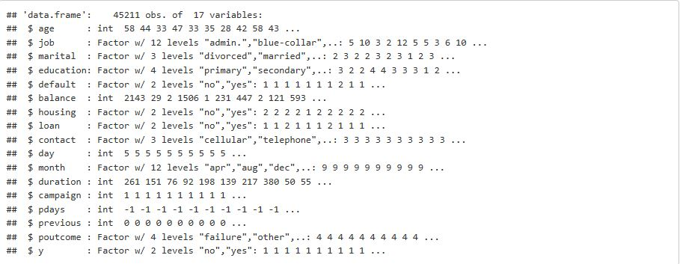
DATA UNDERSTANDING and TOOL USED
Tool used for the assignment is ‘R’
The given data set is a Data Frame structure , with 45211 observation of 17 variables with ”y” as the target variable.
10 variables are Factors and seven variables are Integers

Slide 4
DATA PREPARATION
1.There were no missing values in the given dataset, but there were unknown values in the most of the variables.
2.Continuous variables like Age, Balance ,Campaign, pdays and previous are binned
3.Duration was dropped from further analysis, as it is very much affecting the outcome and duration will only be known only when the customer is contacted.
4.Also, variables default and poutcome are also dropped as the most of the values are same .
5.In the variable contact all unknown values are dropped from further analysis.

Slide 5
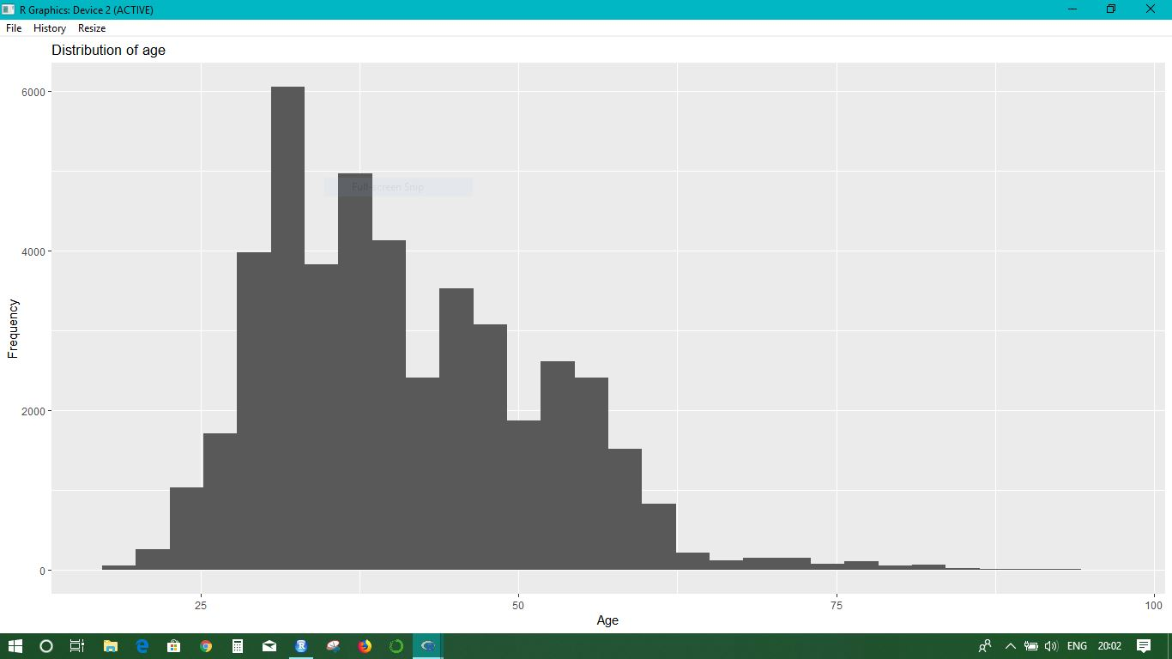
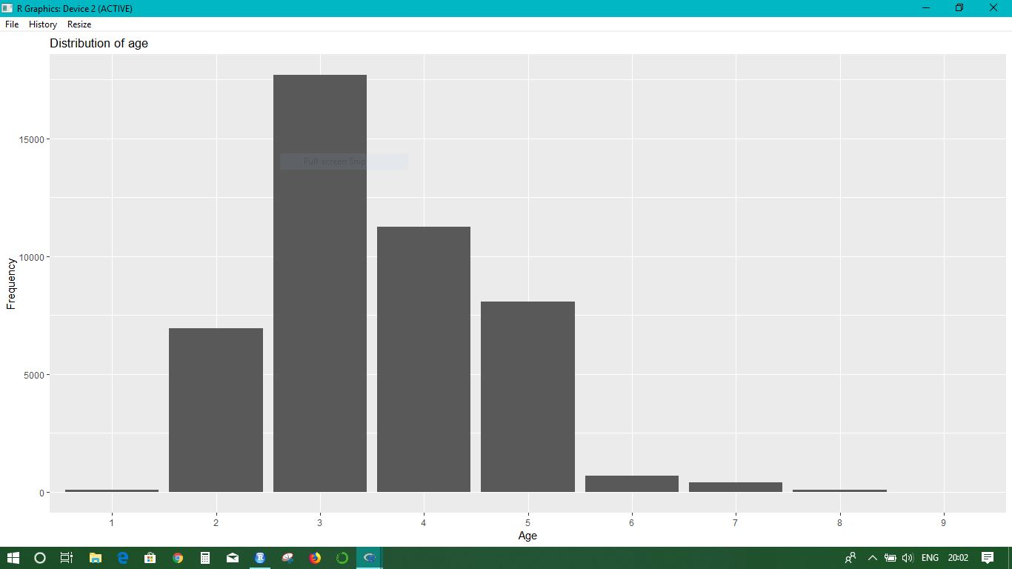
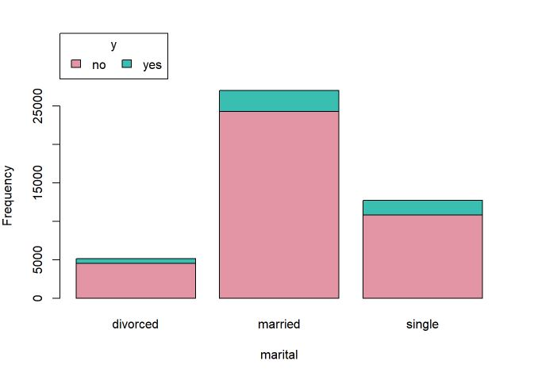
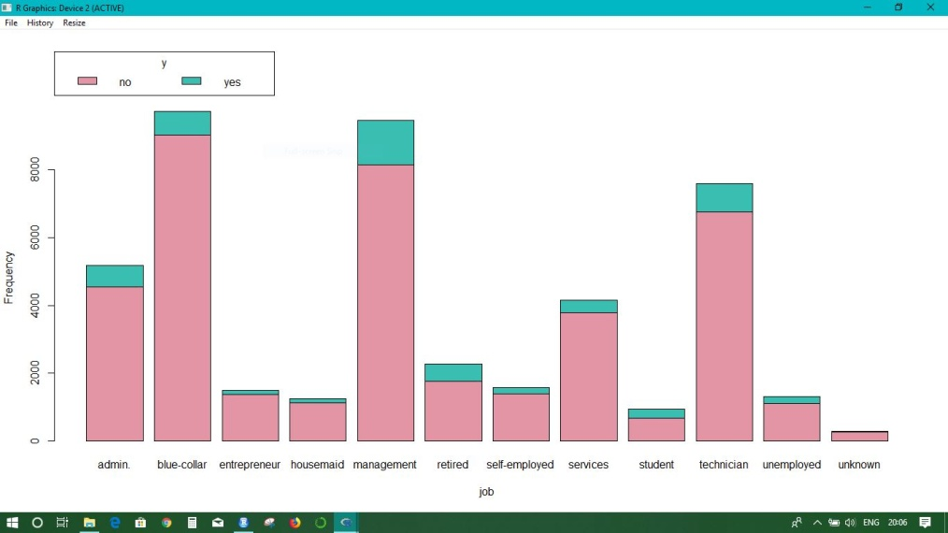
Data Visualization
Age and Age Binned:
Marital stat v/s Outcome
Job Cat v/s Outcome

Slide 6
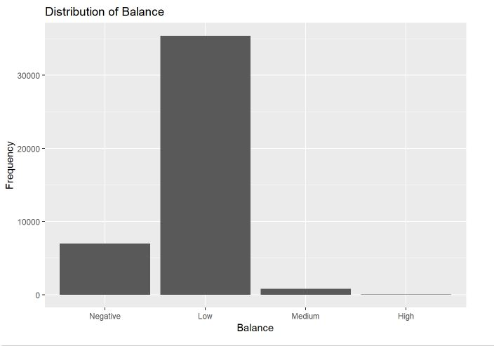
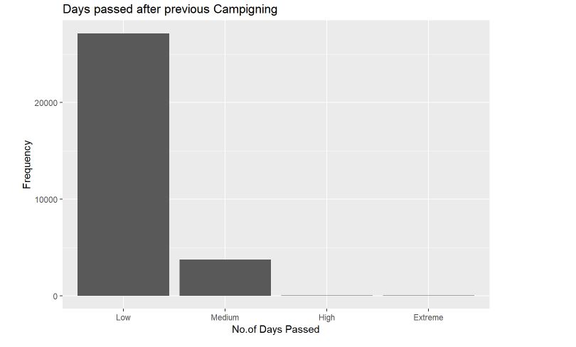
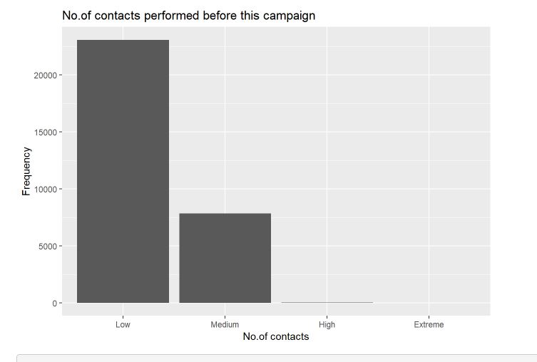
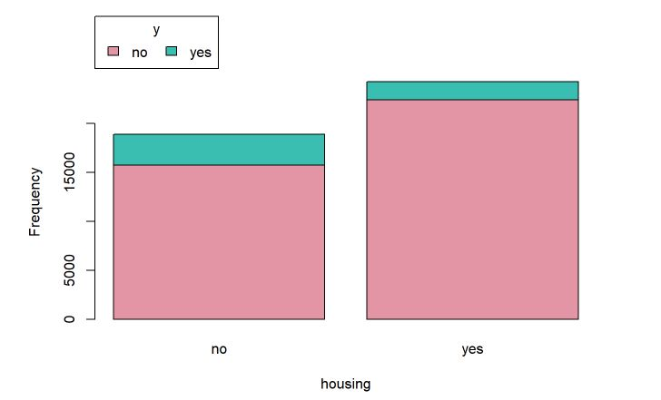
Data Visualization
Balance Distribution
P days binned
Campaign binned
Housing Loan v/s Outcome

Slide 7
MODELLING
1.Given data set has a class imbalance problem that is number of people subscribed for the term deposit are very less than that of the people who did not subscribe.
2.K-fold cross validation sampling technique have been used to reduce the class imbalance problem with 10 folds.
3.Also, Three times repeated k-fold cross validation with 10 fold technique have also been tried.
4.Modelling Techniques used are:
Neural Network
C5.0 Decision Tree
rpart Decision Tree
5.Using ‘trainControl’ function from ‘Caret’ package to implement the above mentioned modelling technique

Slide 8
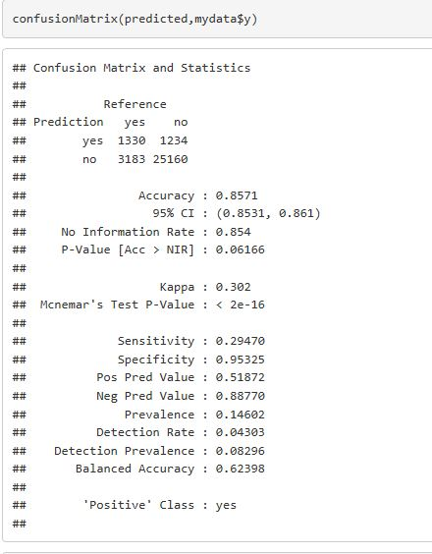
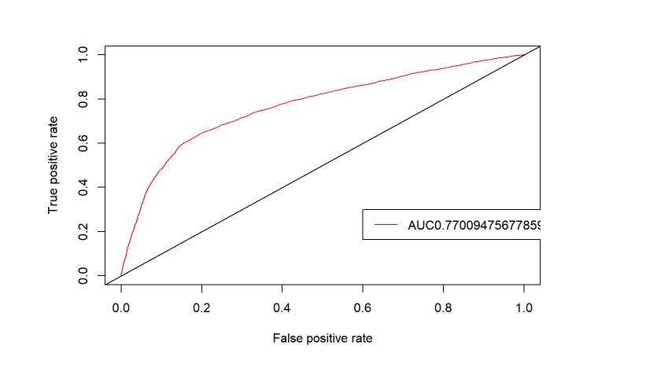
EVALUATION
Confusion Matrix and AUC of Neural Network for 10 fold cross validation.

Slide 9
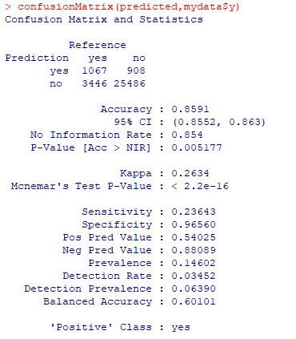
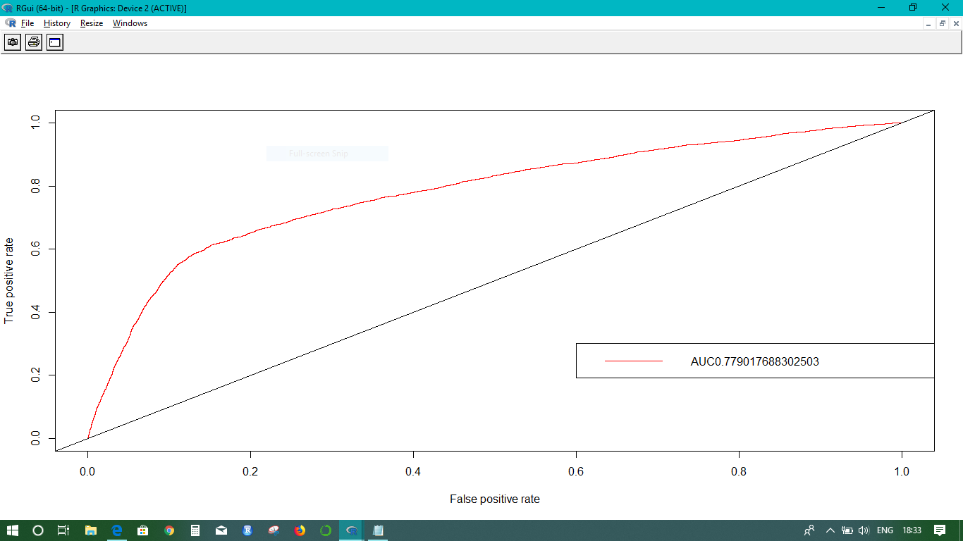
EVALUATION
Confusion Matrix and AUC of Neural Network for 3 times repeated10 fold cross validation.

Slide 10
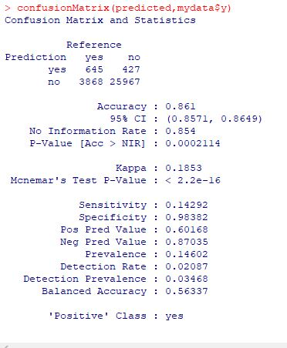
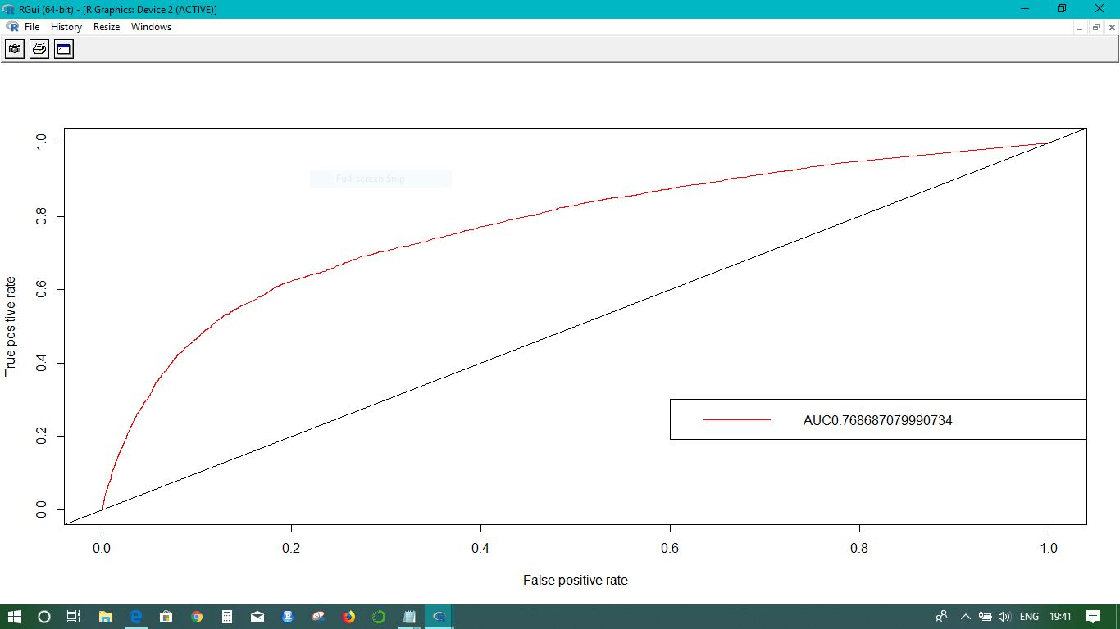
EVALUATION
Confusion Matrix for C50 Decision Tree for 10 fold cross validation

Slide 11
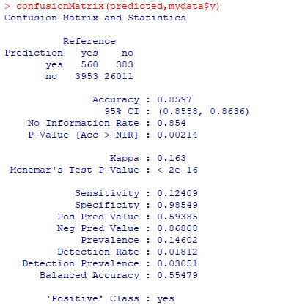

EVALUATION
Confusion Matrix for C50 Decision Tree for 3 times repeated 10 fold cross validation

Slide 12
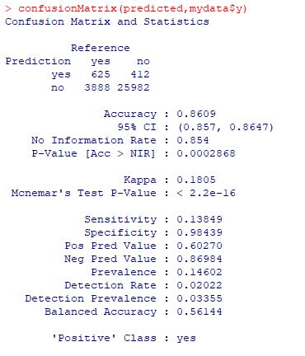
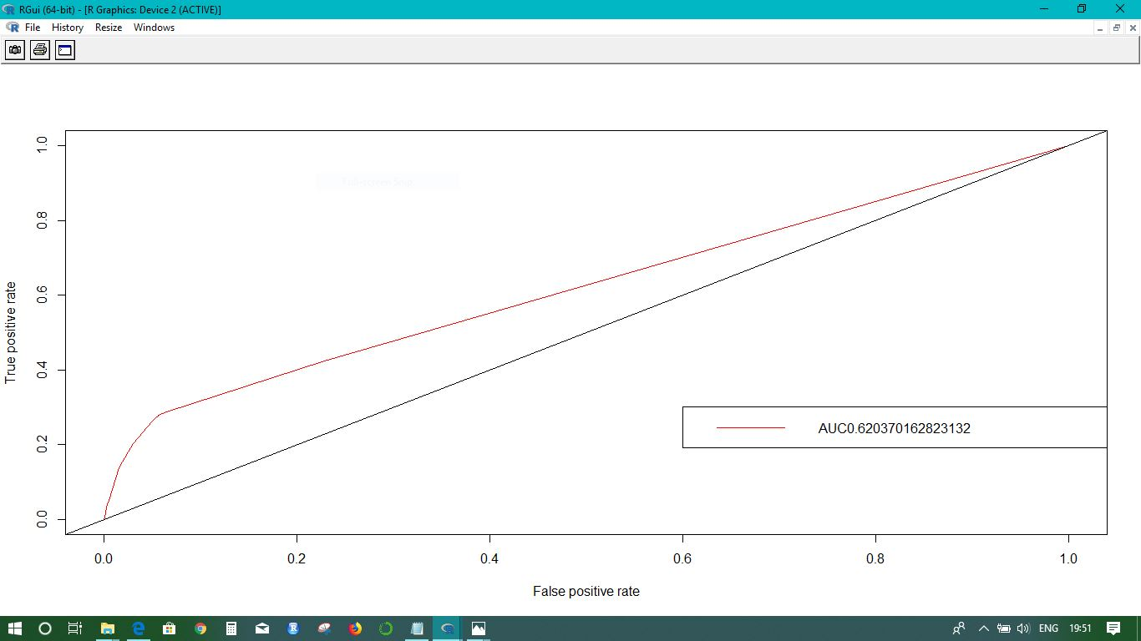
EVALUATION
Confusion Matrix for rpart Decision Tree for 10 fold cross validation

Slide 13
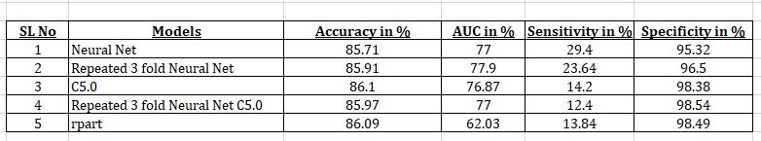
EVALUATION
Summary of Model:
Neural Net works are predicting better than the other two models as it has high percentage of accuracy and AUC values.
Neural Networks has highest ‘Sensitivity’ percentage. Hence selecting this as the best models from the above mentioned models

Slide 14
THANK YOU

